Slide 1

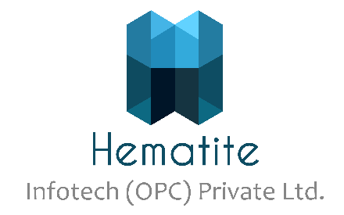
Cloud Computing - Basics
CDAC
1

Slide 2
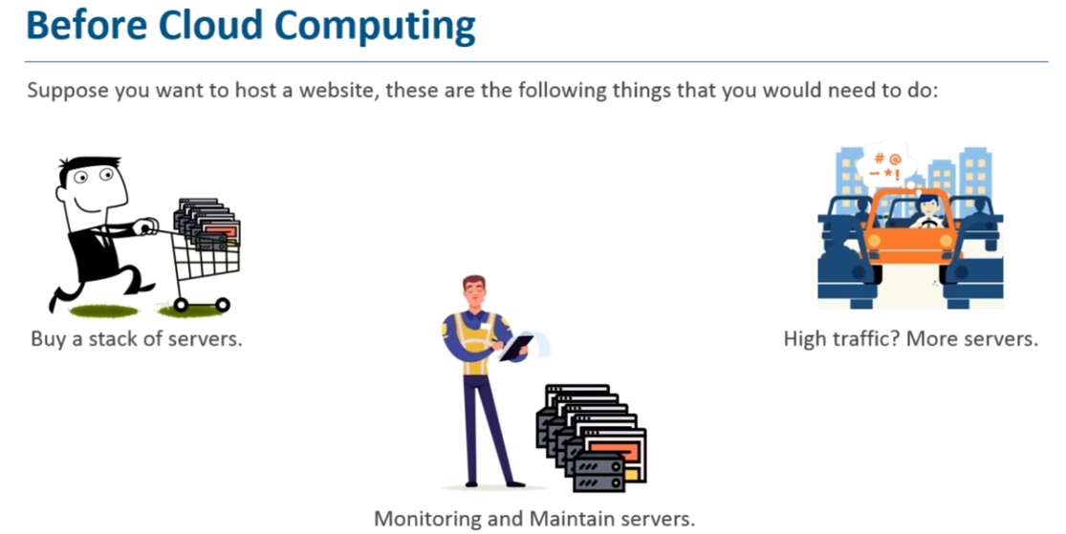

Slide 3
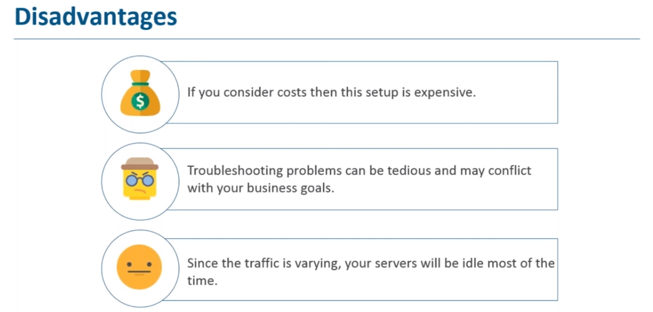

Slide 4
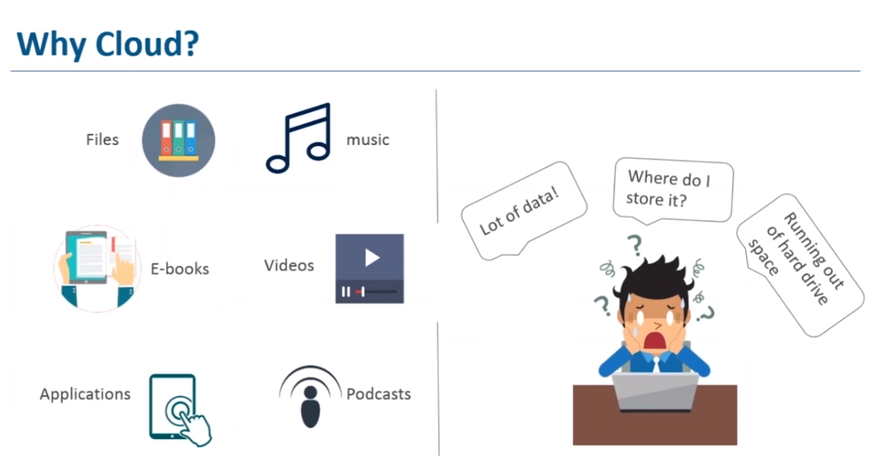

Slide 5
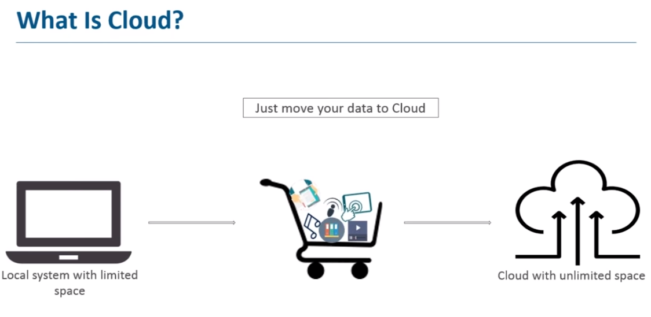

Slide 6
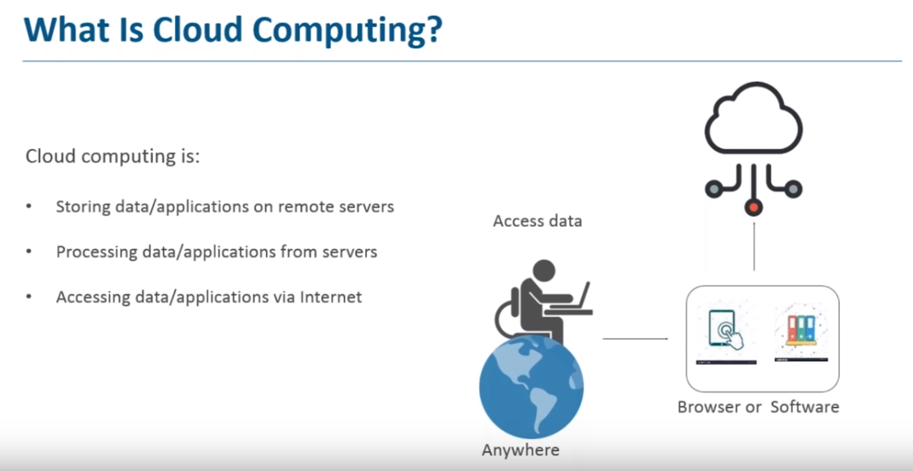

Slide 7
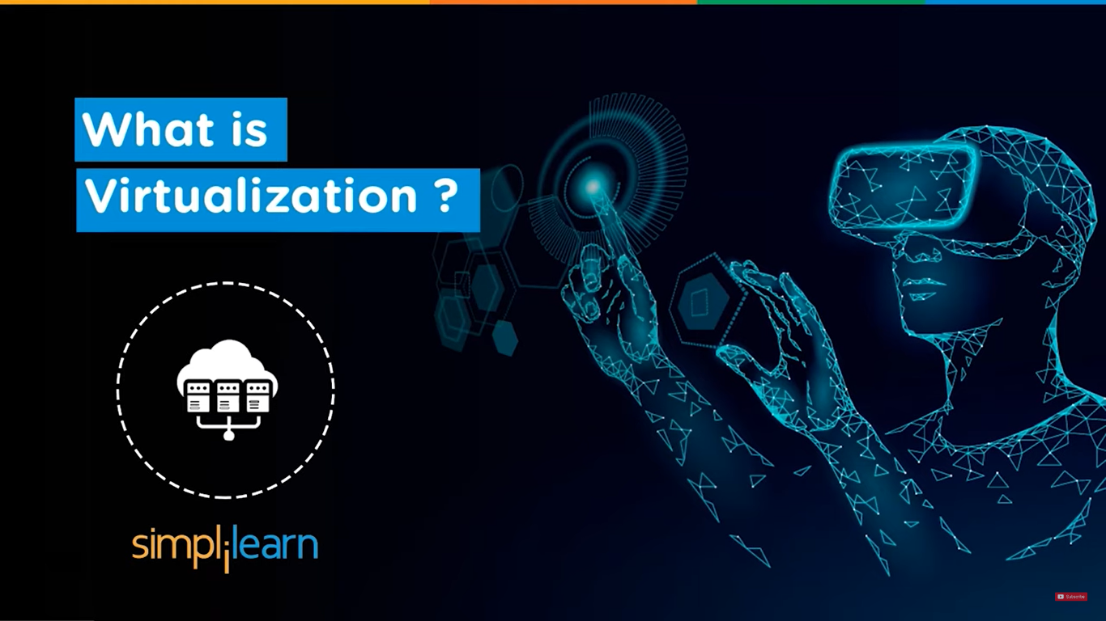

Slide 8
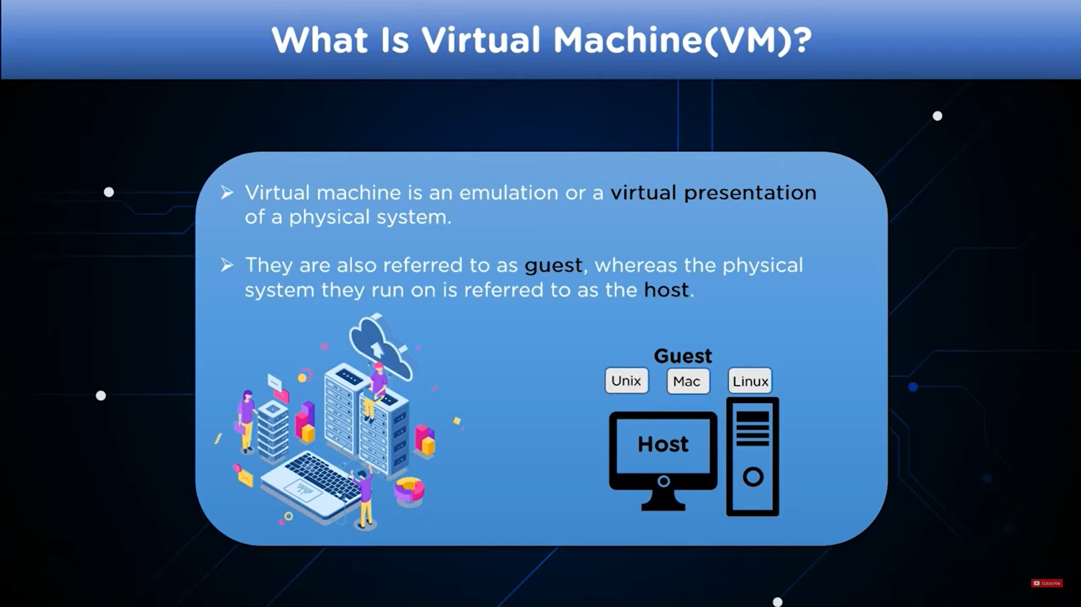
Virtualization
Virtualization is a technique, which allows to share single physical instance of an application or resource among multiple organizations or tenants (customers). It does so by assigning a logical name to a physical resource and providing a pointer to that physical resource on demand.
Creating a virtual machine over existing operating system and hardware is referred as Hardware Virtualization. Virtual Machines provide an environment that is logically separated from the underlying hardware.
The machine on which the virtual machine is created is known as host machine and virtual machine is referred as a guest machine. This virtual machine is managed by a software or firmware, which is known as hypervisor.
virtual machine is an emulation or a virtual presentations of a physical system

Slide 9
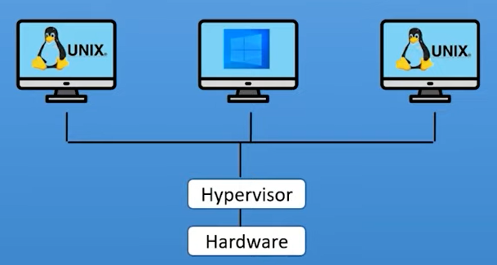
Hypervisor
The hypervisor is a firmware or low-level program that acts as a Virtual Machine Manager.
OR
The hypervisor is a software that manages VMs.
It acts as an interface between VM and Physical hardware to ensure proper access to the resources needed for the working.

Slide 10
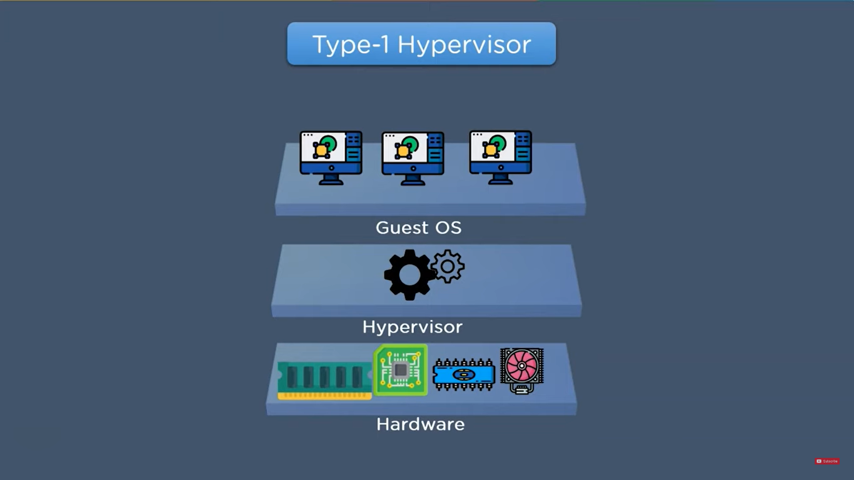

Slide 11
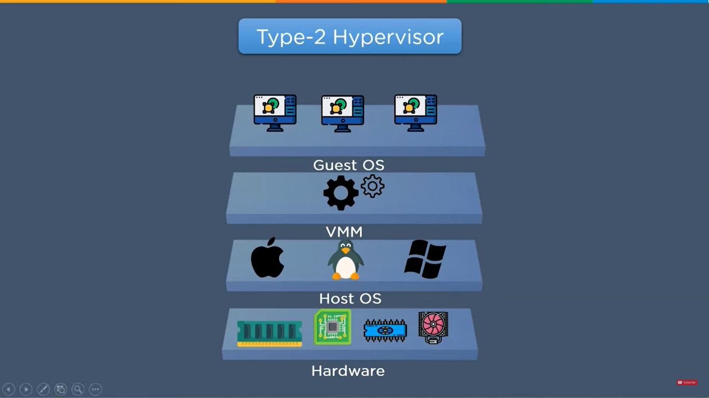

Slide 12
Hypervisor
TYPE-1 Hypervisor: The hypervisor runs directly on the underlying host system. It is also known as a “Native Hypervisor” or “Bare metal hypervisor”. It does not require any base server operating system. It has direct access to hardware resources. Examples of Type 1 hypervisors include VMware ESXi, Citrix XenServer, and Microsoft Hyper-V hypervisor.
Pros: Such kinds of hypervisors are very efficient because they have direct access to the physical hardware resources(like Cpu, Memory, Network, and Physical storage). This causes the empowerment of the security because there is nothing any kind of the third-party resource so that attacker couldn’t compromise with anything.
Cons: One problem with Type-1 hypervisors is that they usually need a dedicated separate machine to perform their operation and to instruct different VMs and control the host hardware resources.

Slide 13
Hypervisor
TYPE-2 Hypervisor: A Host operating system runs on the underlying host system. It is also known as ‘Hosted Hypervisor”. Such kind of hypervisors doesn’t run directly over the underlying hardware rather they run as an application in a Host system(physical machine). Basically, the software is installed on an operating system. Hypervisor asks the operating system to make hardware calls. An example of a Type 2 hypervisor includes VMware Player or Parallels Desktop. Hosted hypervisors are often found on endpoints like PCs. The type-2 hypervisor is very useful for engineers, and security analysts (for checking malware, or malicious source code and newly developed applications).
Pros & Cons of Type-2 Hypervisor:
Pros: Such kind of hypervisors allows quick and easy access to a guest Operating System alongside the host machine running. These hypervisors usually come with additional useful features for guest machines. Such tools enhance the coordination between the host machine and the guest machine.
Cons: Here there is no direct access to the physical hardware resources so the efficiency of these hypervisors lags in performance as compared to the type-1 hypervisors, and potential security risks are also there an attacker can compromise the security weakness if there is access to the host operating system so he can also access the guest operating system.

Slide 14
Choosing the right hypervisor :
Type 1 hypervisors offer much better performance than Type 2 ones because there’s no middle layer, making them the logical choice for mission-critical applications and workloads. But that’s not to say that hosted hypervisors don’t have their place – they’re much simpler to set up, so they’re a good bet if, say, you need to deploy a test environment quickly. One of the best ways to determine which hypervisor meets your needs is to compare their performance metrics. These include CPU overhead, the amount of maximum host and guest memory, and support for virtual processors.
The following factors should be examined before choosing a suitable hypervisor:
Understand your needs:
The cost of a hypervisor
Virtual machine performance
Ecosystem

Slide 15
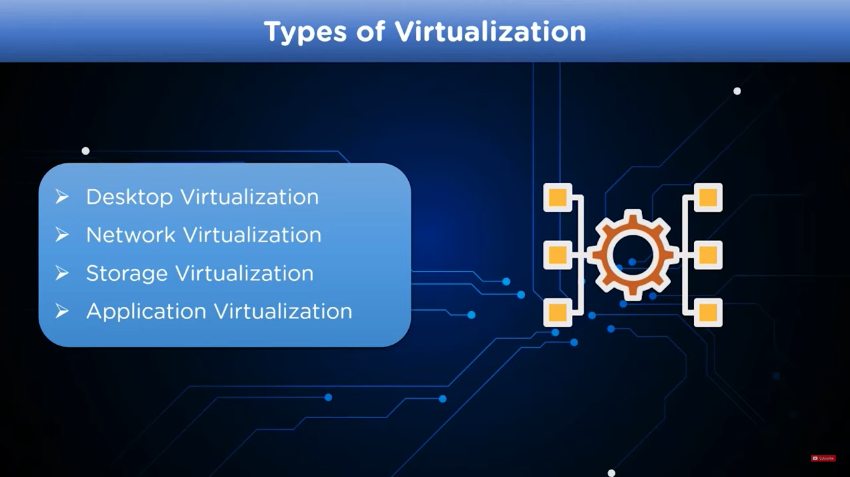

Slide 16
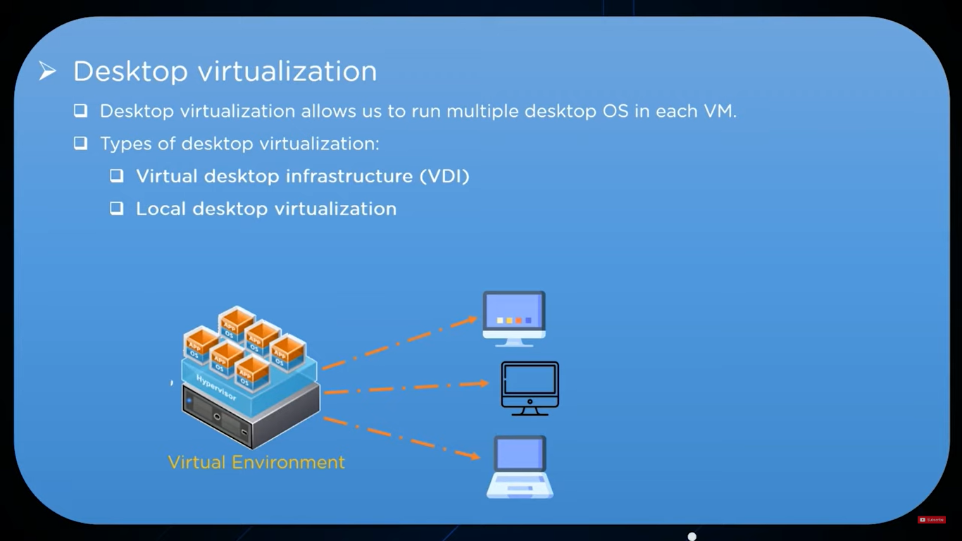

Slide 17
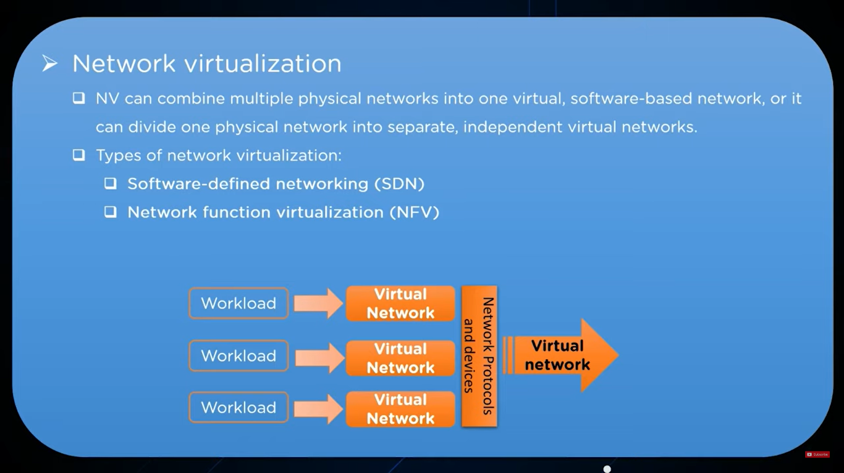

Slide 18
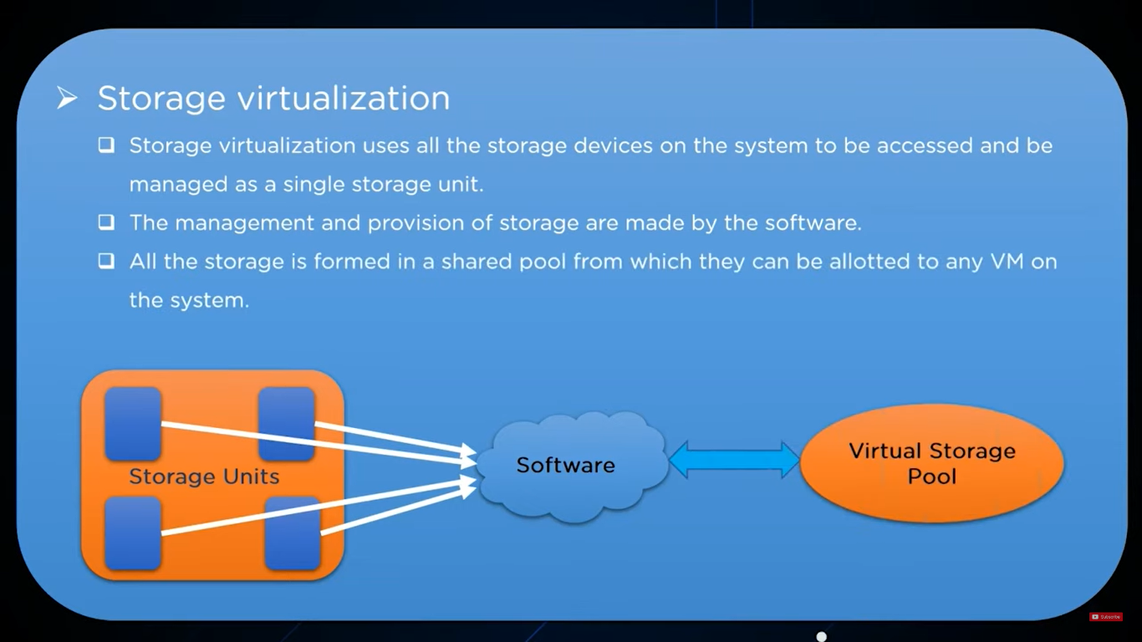

Slide 19
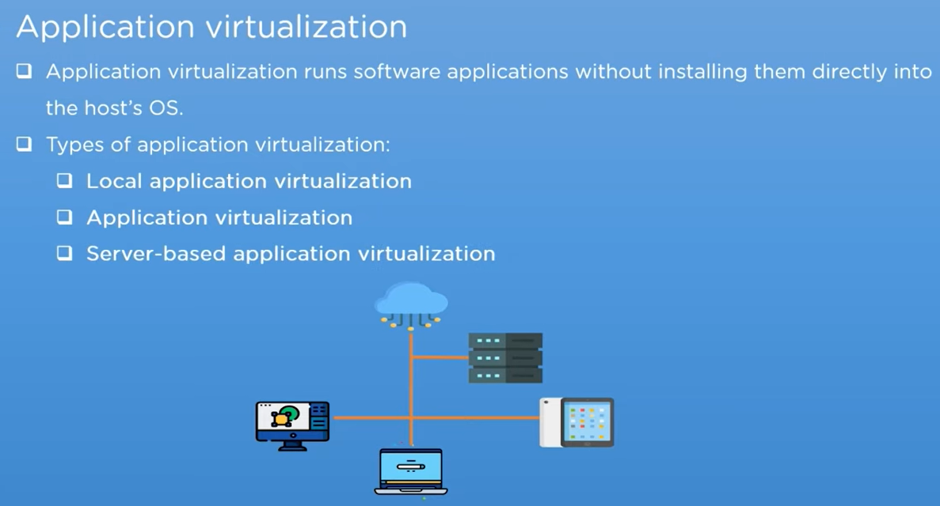

Slide 20
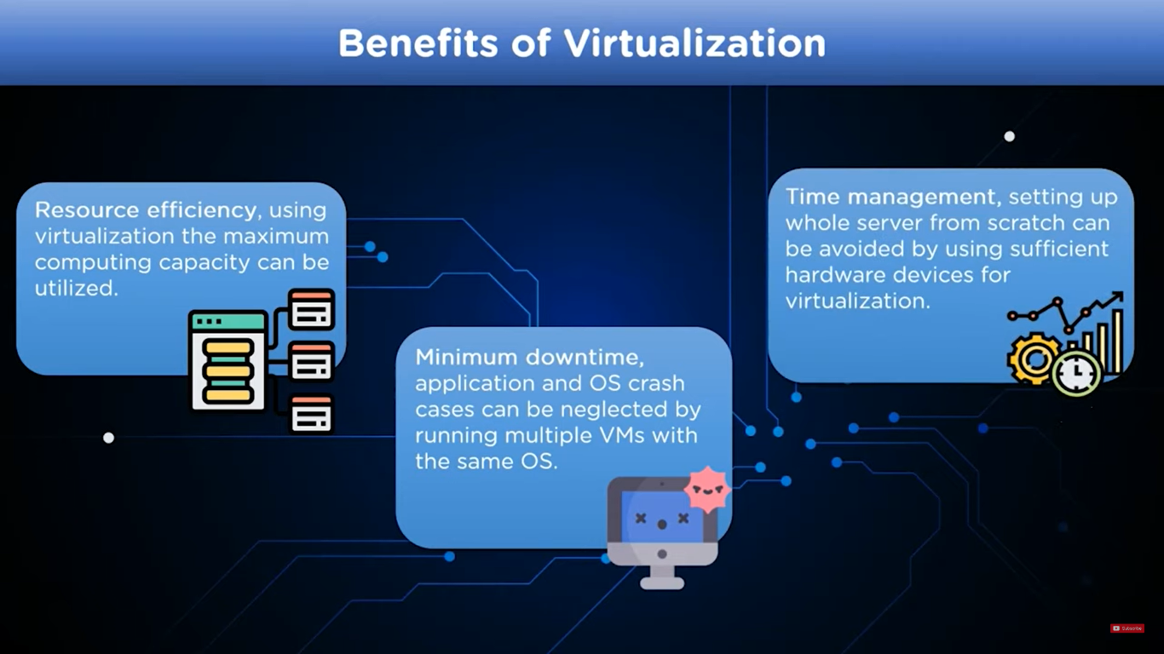

Slide 21
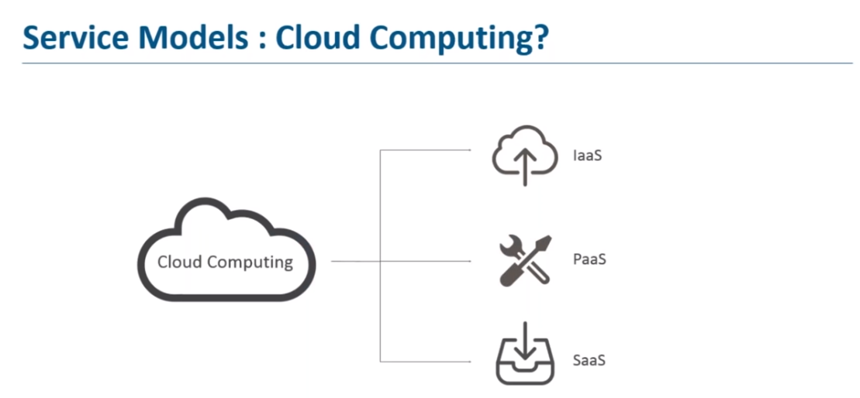

Slide 22
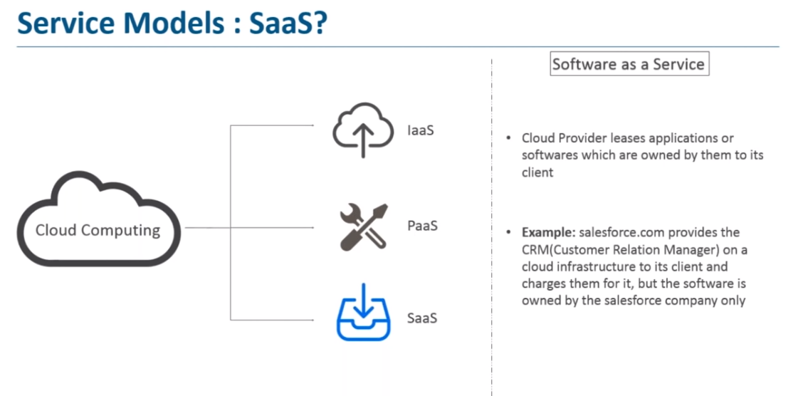

Slide 23
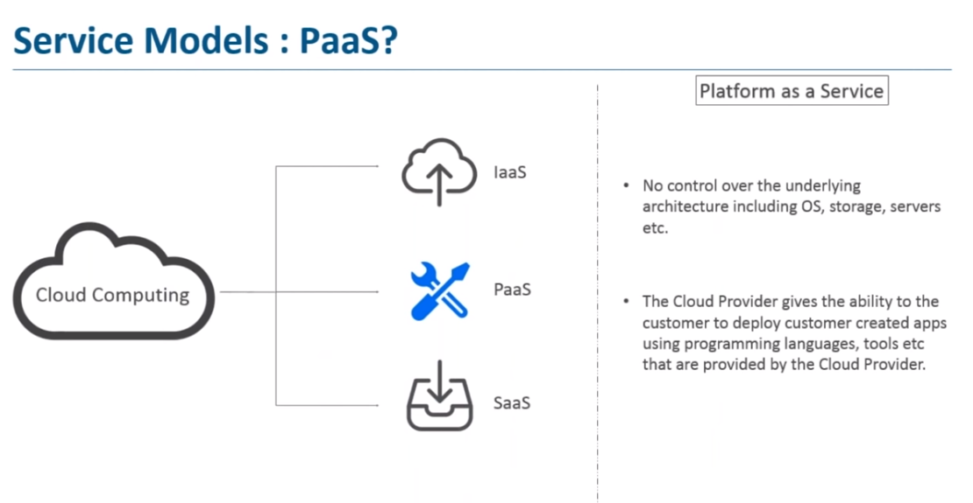

Slide 24
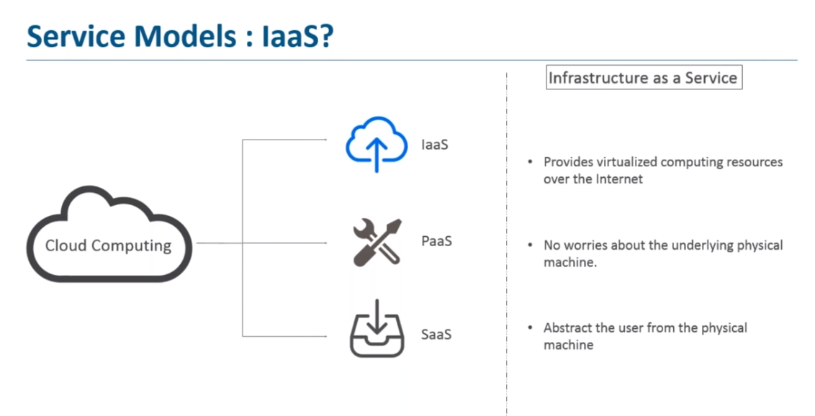

Slide 25
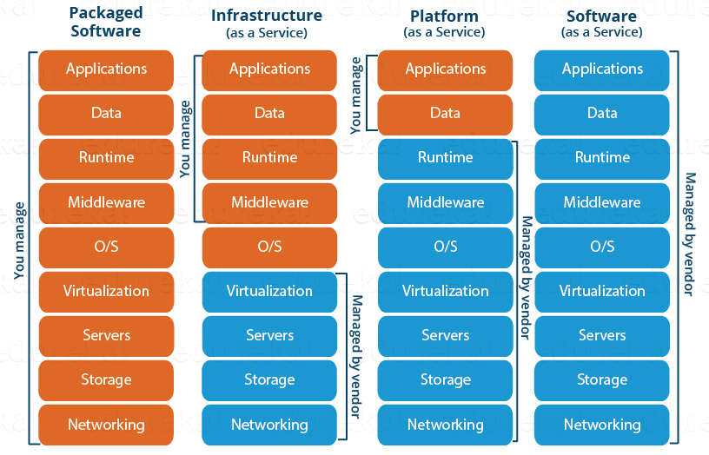
Cloud Offerings

Slide 26
What Is AWS EC2?
AWS EC2 (Amazon Web Services Elastic Compute Cloud) is a service that allows for using virtual machines called EC2 instances in the cloud and providing scalability. You can change the amount of disk space, CPU performance, memory etc. whenever you need. You can select the base image with the necessary pre-installed operating system (OS) such as Linux or Windows and then configure most OS settings as well as installing custom applications. You have the root access for your Amazon EC2 instances and can create additional users. Manage everything you need and fully control your EC2 instances including rebooting and shutting down the instance. The category of AWS EC2 web service is known as Infrastructure as a Service. AWS EC2 can be used for cloud hosting – you can deploy servers as virtual machines (instances) in the cloud.
AWS EC2 has a wide range of use cases since almost everything can be configured when using this service. The most common use cases of AWS EC2 are:
Hosting web sites
Developing and testing applications or complex environments
High performance computing
Disaster recovery

Slide 27
What Is AWS Lambda?
AWS Lambda is a computing platform that allows you to run a piece of code written on one of the supported programming languages – Java, JavaScript, or Python when a trigger linked to an event is fired. You don’t need to configure a virtual server and environment to run an application you have written. Just insert your program code (called Lambda function in this case) in the AWS Lambda interface, associate the Lambda function with the event and run the application in the cloud when needed, without taking care of server management and environment configuration. This way, you can focus on your application, not on server management—this is why AWS Lambda is referred to as serverless.
General use cases of AWS Lambda:
Automating tasks
Processing objects uploaded to Amazon S3
Real-time log analyzing
Real-time filtering and transforming data

Slide 28
Amazon S3
Amazon Simple Storage Service (Amazon S3) is an object storage service offering industry-leading scalability, data availability, security, and performance. Customers of all sizes and industries can store and protect any amount of data for virtually any use case, such as data lakes, cloud-native applications, and mobile apps. With cost-effective storage classes and easy-to-use management features, you can optimize costs, organize data, and configure fine-tuned access controls to meet specific business, organizational, and compliance requirements.

Slide 29
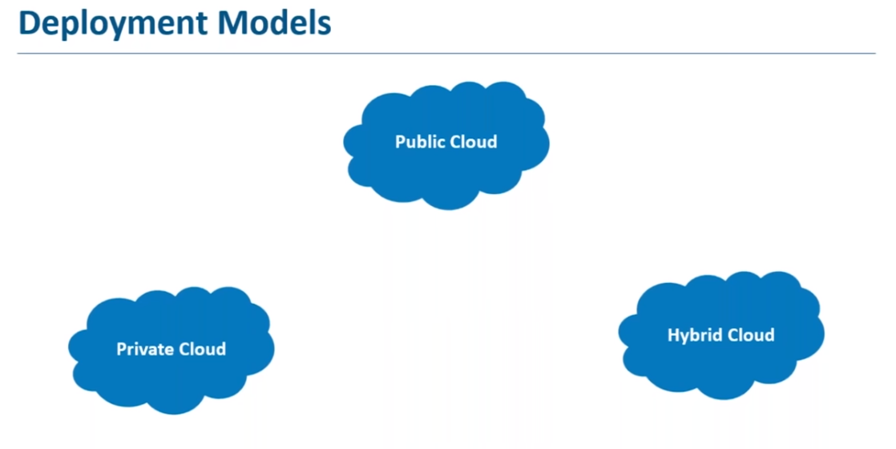

Slide 30
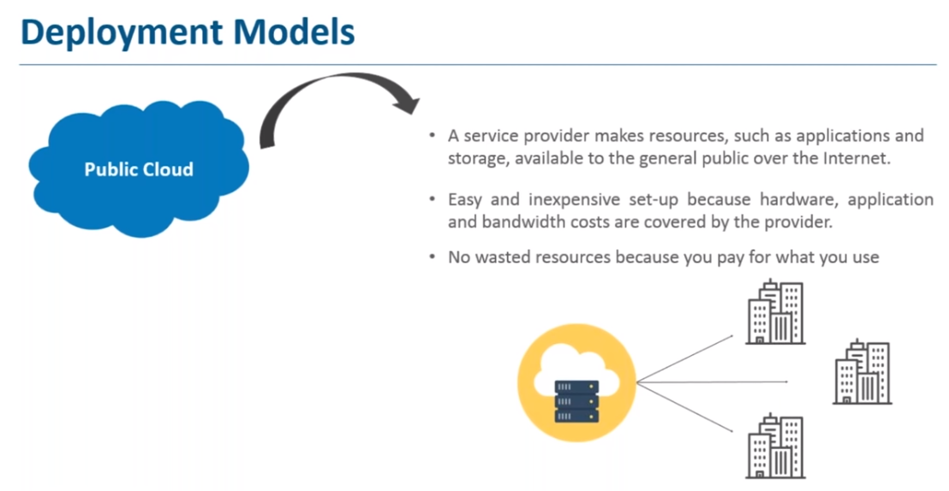

Slide 31
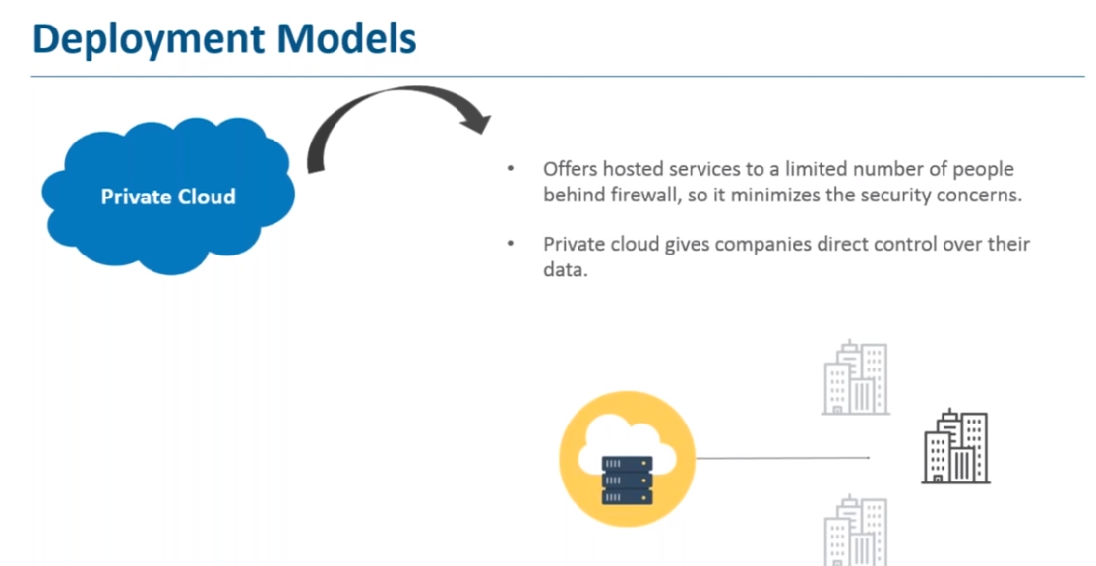

Slide 32
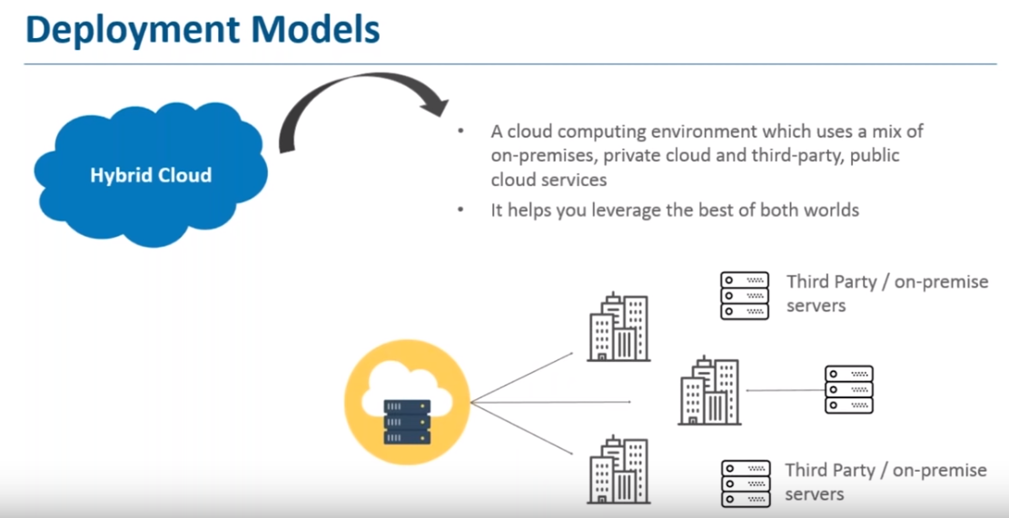

Slide 33
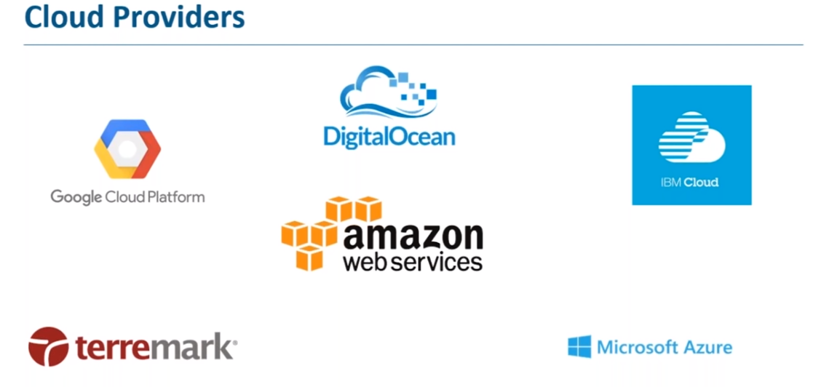

Slide 34
Cloud Notes

Slide 35
What is Cloud Computing?
What is Cloud Computing? Cloud Computing often referred to as “the cloud”, in simple terms means storing or accessing your data and programs over the internet rather than your own hard drive.
You do not have to maintain or administer any infrastructure for the same.
It will never run out of capacity, since it is virtually infinite.
You can access your cloud based applications from anywhere, you just need a device which can connect to the internet.

Slide 36
Cloud Computing – Daily Use
Now that you have a fair idea, what cloud is, just think about all your daily activities online, and you will realize that a lot of your work that you do online is based on cloud. Like your social media interactions are all on the cloud, anything that you store online, is again cloud, you paying your electricity bills online, online shopping, everything!
Now how does it all work, let’s understand it through an example:
So, there is this application called the Customer Relation Manager (CRM) which is based on the cloud. This software is highly used in all the Sales organisations for better agility, enhanced productivity and low costs.
The way it is used is like this; a field sales representative would need an access to a mobile device which is connected to the internet and then he can retrieve the customer information irrespective of his location. Also, he can update the information on the go therefore no need of going back to the office to update the deal information.
The sales managers can also monitor everything on their internet enabled devices, and will know which deals to close or not. It all happens on the go!
The best part? You don’t have to buy any machines or administer any kind of software, it all will be handled by the cloud company which is running this application. Cool right?

Slide 37
Cloud Categories
Public Cloud
Private Cloud
Hybrid Cloud
Public Cloud
In a public cloud deployment mode, the services which are deployed are open for public use and generally public cloud services are free. Technically there maybe no difference between a public cloud and a private cloud, but the security parameters are very different, since the public cloud is accessible by anyone there is a more risk factor involved with the same.
Private Cloud
A private cloud is operated solely for a single organization, it can be done by the same organization or a third-party organization. But usually the costs are high when you are using your own cloud since the hardware would be updated periodically, security also has to be kept in check since new threats come up every day.
Hybrid Cloud
A hybrid cloud consists the functionalities of both private and public cloud. How?

Slide 38
Advantages of Cloud
Fast Implementation If you’ve been there for a development or implementation of an application, it takes sometimes months or even years to make the application up and running, with cloud you can cut through the time and make things faster.
Instant Scalability With cloud resources you can always scale up or scale down the no. of resources and users according to your need, the cloud capacity never runs out! Access Anywhere Applications built on cloud are designed to be accessed from anywhere, you just need an internet connection on a mobile device.
No Upfront Costs & Maintenance Free Traditionally you would have to patch your software with the latest releases, upgrade your hardware and also troubleshoot faults in your system at the hardware level, but with cloud you don’t have to worry about the maintenance of your hardware, it will all be managed by your cloud provider.
Better Security An Independent study found that yearly a medium scale company loses around 260 laptops, this is a loss to the company not in monetary terms, but the data that was there on the laptop is valuable, with Cloud you don’t have to worry about that, all your data is stored in a centralized secure location.

Slide 39
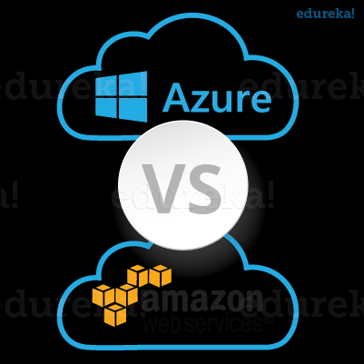
There are tons of cloud providers out there to choose from. Let us take the most prominent ones.
Azure: It’s a cloud computing platform by Microsoft founded in 2010.
AWS: Amazon Web Services is a cloud computing platform by Amazon in 2006.
Which one will you choose?
A question which would have crossed your mind, the moment you saw the two names.

Slide 40





Thank You
Girish Godbole
+91 9850625655
Godbole.girish@gmail.com
www.hematitecorp.com
40

